Slide 1

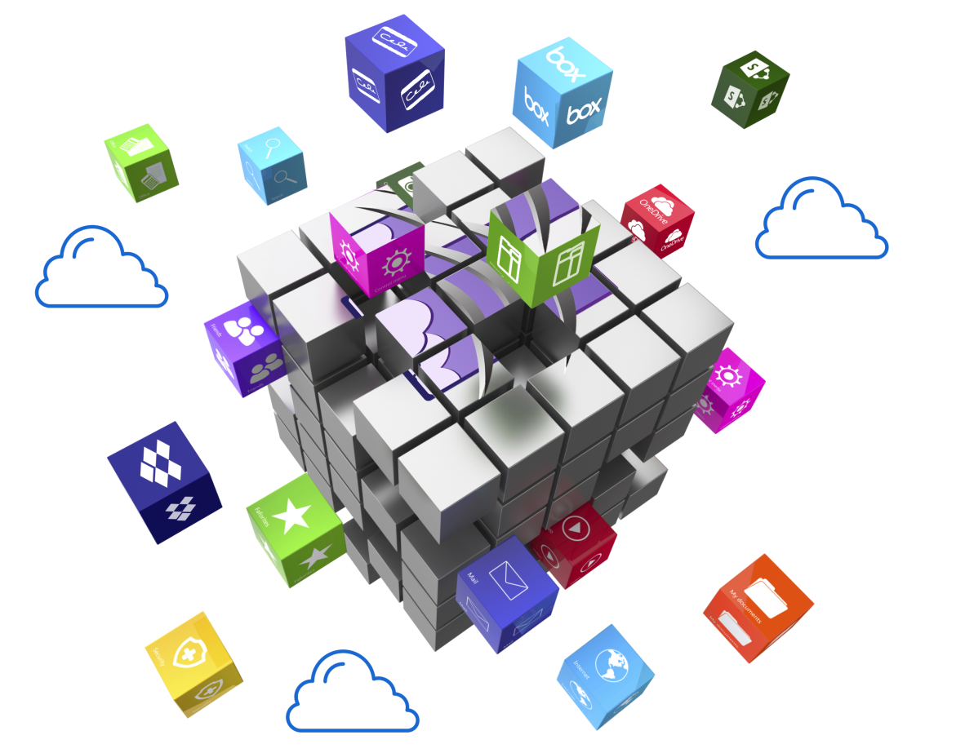

Sales Training
Notes:
Welcome to the Dispatcher Stratus sales training module! Today, we're going to be discussing Konica Minolta's cloud workflow automation solution known as Dispatcher Stratus, discussing it's key differentiators and features, as well as how automation can positively impact our customers operations. Let's get started!

Slide 2








The Dispatcher Family
Advanced workflow with support for both on-premise
& hybrid installations!
True Cloud Workflow Management

Slide 3

Dispatcher ScanTrip Cloud
Driving digital transformation by uniting people, processes and automation.
Key Benefits:
  Platform for Bridging MFP to Cloud
  Multi-Tenant Solution with Simplified Onboarding
  Cloud Intelligent Process Automation
  Zero Trust Security
  Flexible MFP Forms Management
  Providing one of the industry’s strongest cloud offerings of scan and print management when paired with Paragon Cloud

Slide 4

Dispatcher Stratus
Transforming traditional workflow automation into a next generation true cloud platform for business process and file automation, MFP/PC-based forms, we well as
collaboration through task-driven
automation and people-based
workflows.
The Dispatcher Stratus Platform is designed for anytime/anywhere access to support the new hybrid work environment. Dispatcher Stratus will provide secure, scalable, flexible, and reliable solutions for customers that make it smarter and easier to work, while eliminating reliance on IT infrastructure and reducing costs.​

Slide 5

Dispatcher Stratus Value Proposition
True-cloud advanced workflow automation - no on-premise infrastructure required.
Capture paper-based and electronic documents into any workflow for processing.
Increase security throughout document processing
Quickly and easily monitor workflow progress and ongoing tasks.
Streamline document verification and approval
workflows in a single web-based interface.
Digital form creation and management for document generation and capture.
Engage employees with People-Based Workflows!
Powerful integrations to automatically process and route documents and data.
Proactively monitor customer activity, health, and status through Tenant Management.

Slide 6
3 Types of Automation with Dispatcher Stratus
1
2
3
People-Based Workflows w/ Automation
Fully Automated Workflows
People-Based Workflows

Slide 7
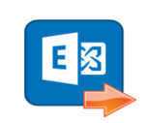





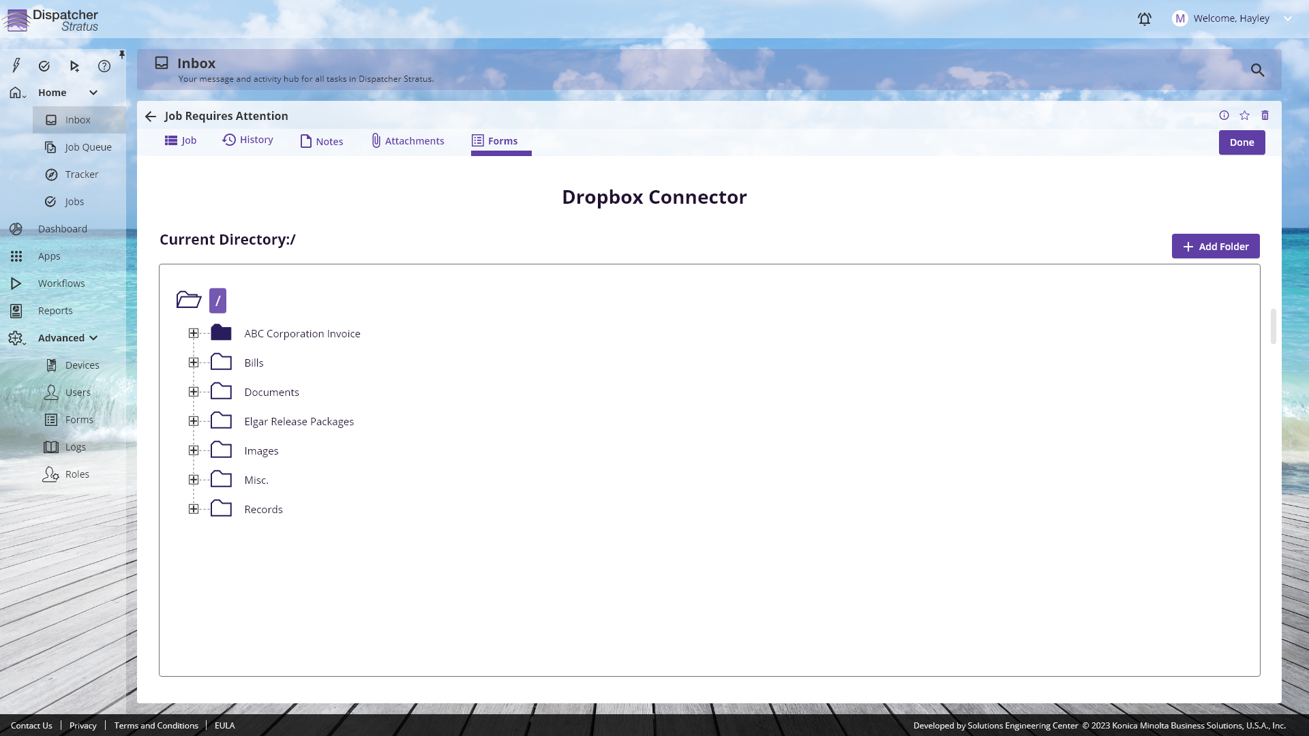
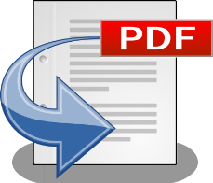

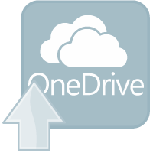

Automated Workflows
Use Cases:
App to App Data Reconciliation
Order and Invoice Processing
Account Receivable
Workflows can be configured to completely automate business processes such as document capture from cloud folders, email or fax with zonal OCR and intelligent routing.

Slide 8
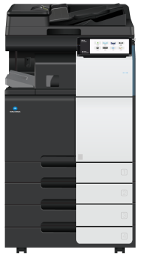
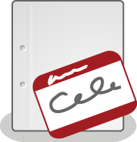





People-Based Workflow with Automation
Use Cases:
Price Exceptions
Data/Design Verification
Often, jobs require a mix of automation and user tasks. Dispatcher Stratus can combine these into a single workflow to further streamline business processes.

Slide 9





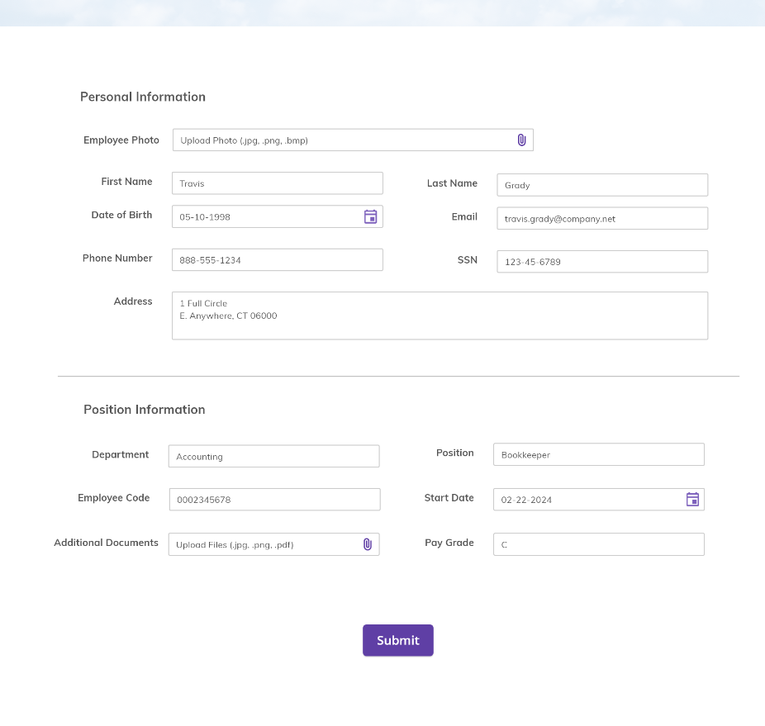
People-Based Workflow
Use Cases:
Reviews & Approvals
Human Resources
Vacation or IT Requests
Tasks and instructions for each user are sent to each step of the job. Whether sent to a group leader, individual, or picked from a queue, each user has access to attachments, notes, and forms to complete the job.

Slide 10
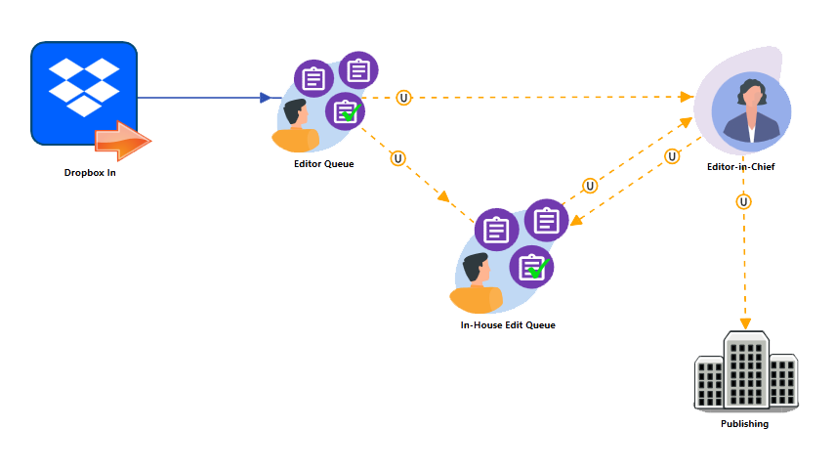

People-Based Workflows
  Combine IDP with human touchpoints
  Facilitate workflows that require manual intervention with ease
  Automated job notifications
  Supports shared job queues and group distribution

Slide 11

Key Features
Notes:
Let’s discuss some of the key features of the Dispatcher ScanTrip Cloud solution.

Slide 12
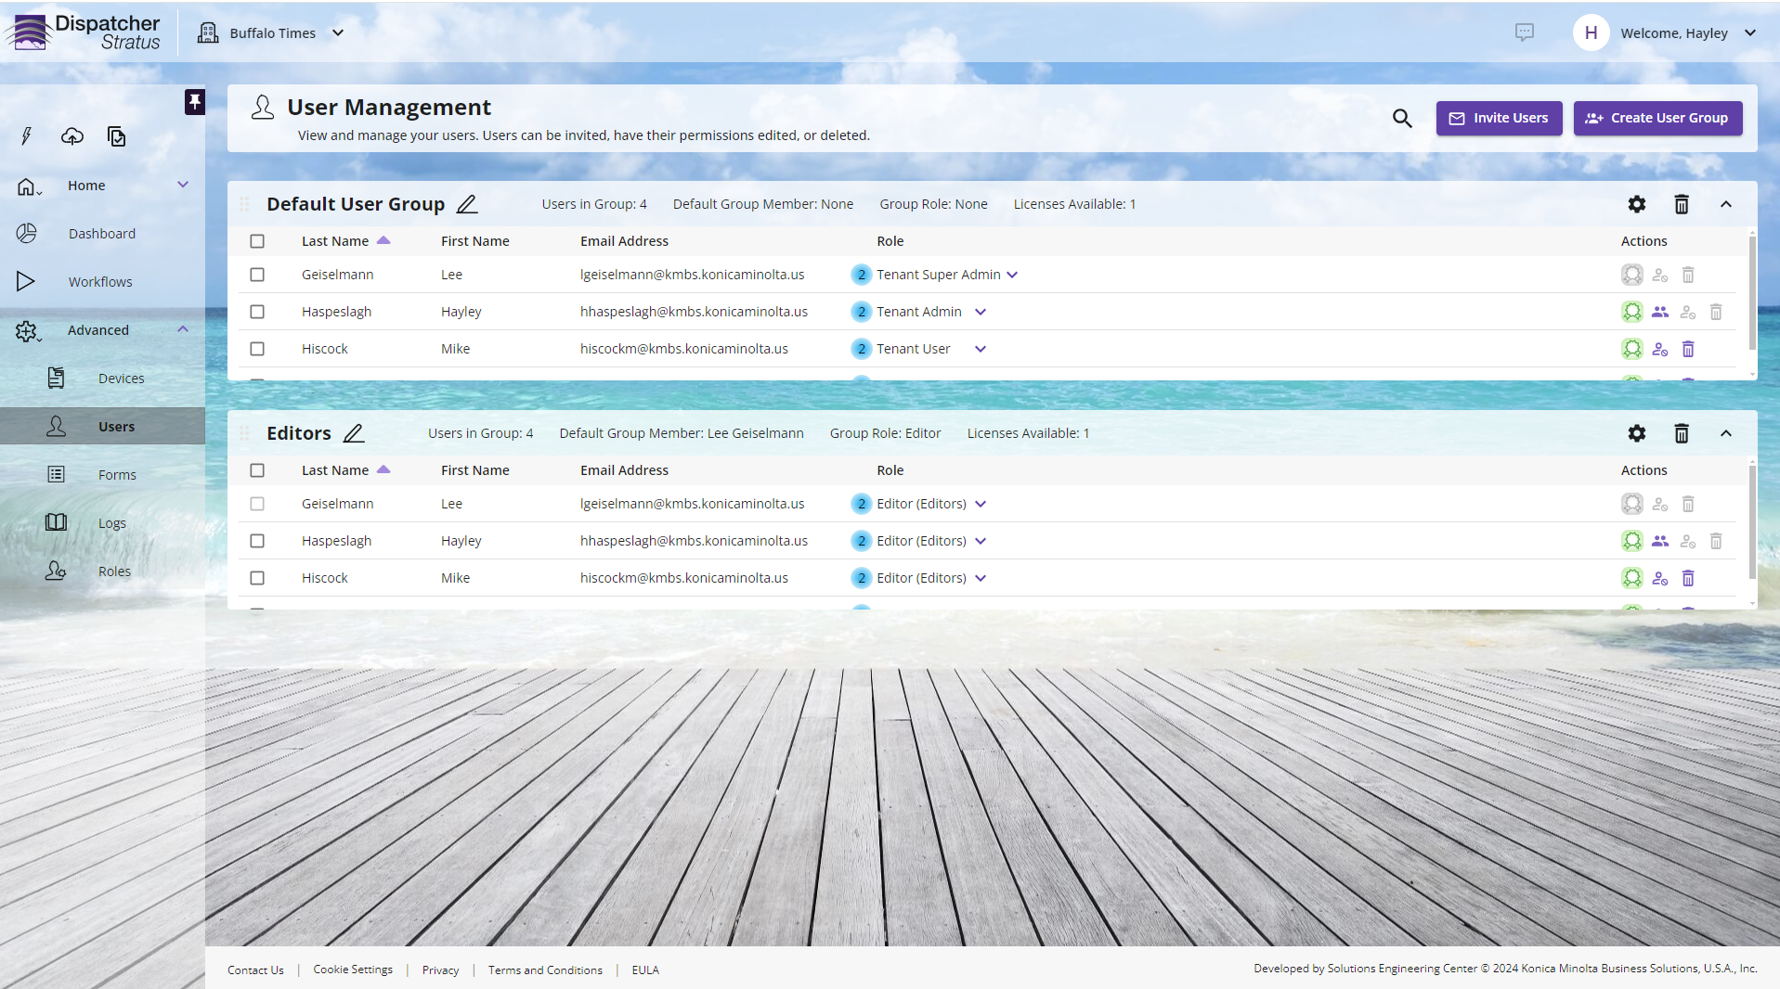
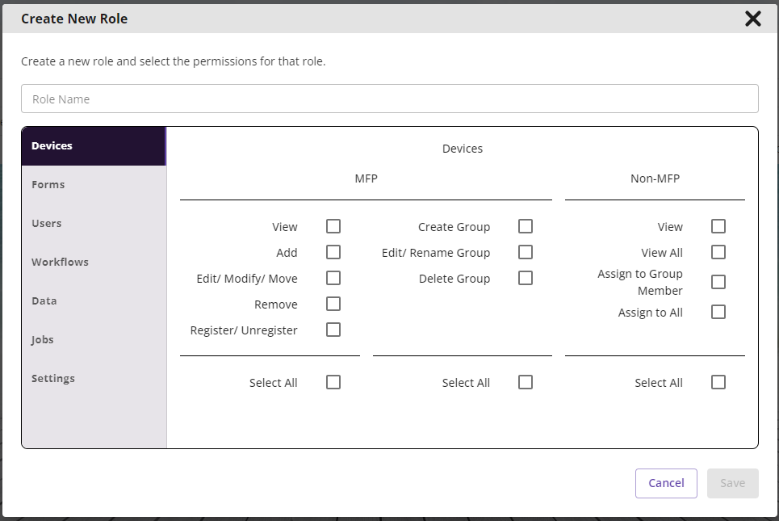
End-to-End Security
  Multiple configurable authentication methods for the portal and MFPs, including card readers and single sign-on (SSO)
  Secure print release with Release2Me
  MFP security compliance monitoring
  Direct connectors to popular DMSs, email systems, and MFPs

Slide 13
Granular Roles & Permissions
  Streamline group creation with built-in roles
  Custom roles allow for unique permissions for user groups
  Integrated with people-based workflows for job management

Slide 14


Release2Me Cloud
  Secure print release in the cloud
  Print queue options - Personal, Delegated, Shared, and Guest - ensure document security
  Documents can be automatically deleted from a queue after printing or saved for future printing
  Robust reports keep managers apprised of organizational trends

Slide 15

bizhub SECURE Notifier
  MFP fleet security monitoring from within the tenant
  Configurable individual or group policies
  On-demand and automated status change emails

Slide 16


Powerful Integrations
  Processed documents sent automatically to other systems.
  Integrates with a growing list of popular ECM solutions (ex: Square 9).
  Direct integrations with enterprise solutions providers and legacy systems.
  Powerful system to system intelligent process automation/RPA.

Slide 17
Connectivity to Dispatcher Phoenix
  Leverage the power and strength of both platforms
  Take advantage of local processing speeds for high volume tasks
  Empower users to collaborate in the cloud while keeping control of data

Slide 18

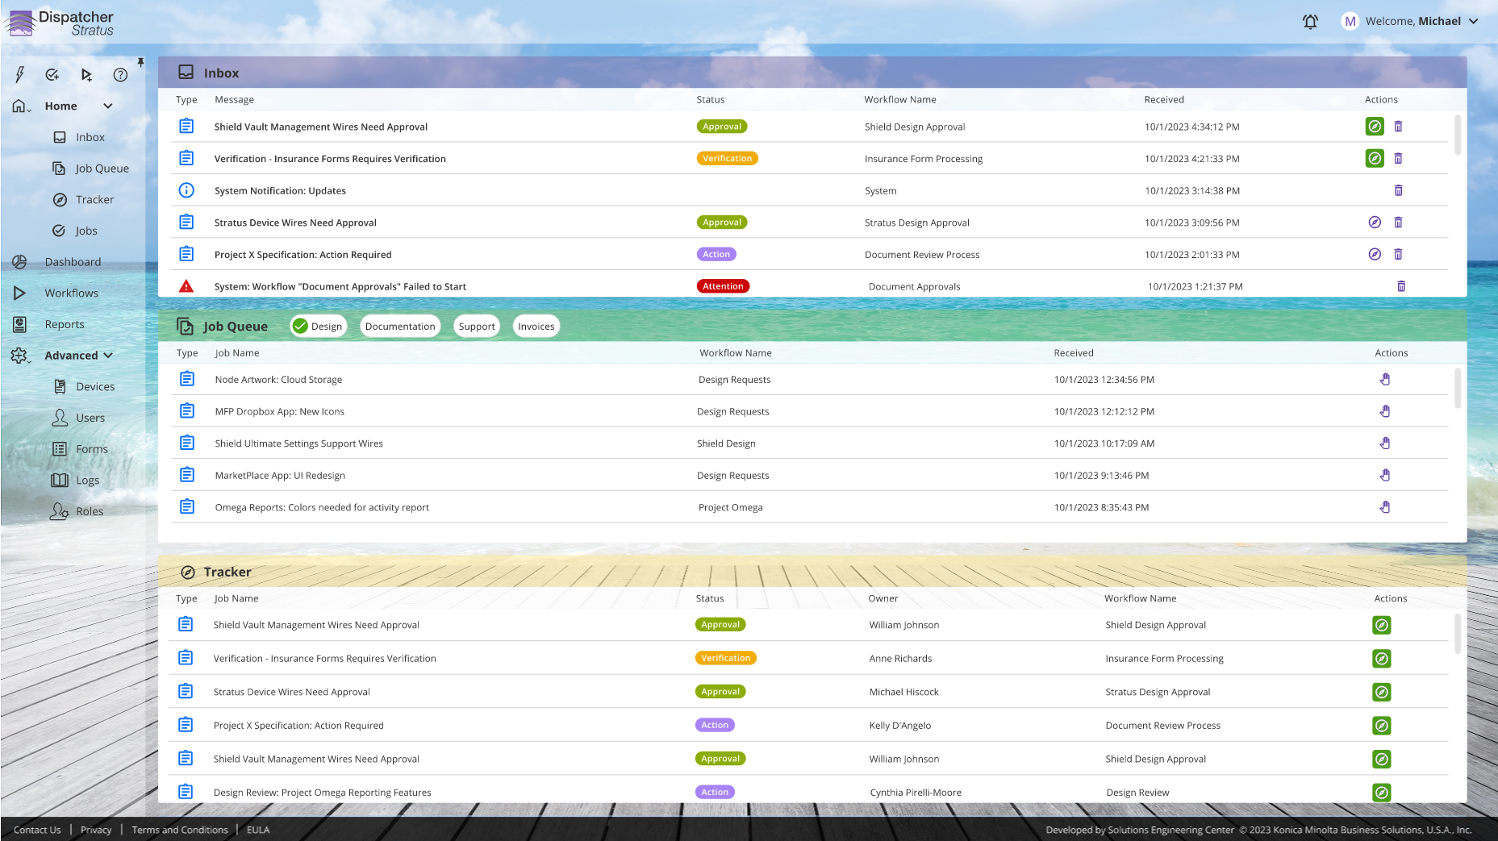
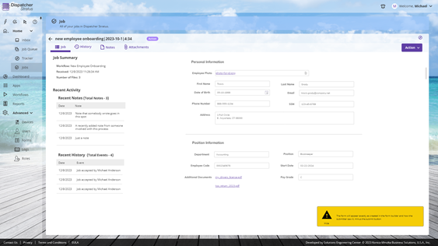
Home Page / Job Queue Management
  Workflow Inbox so users can see the tasks that have been assigned to them.
  Automated reminders/notifications.

Slide 19

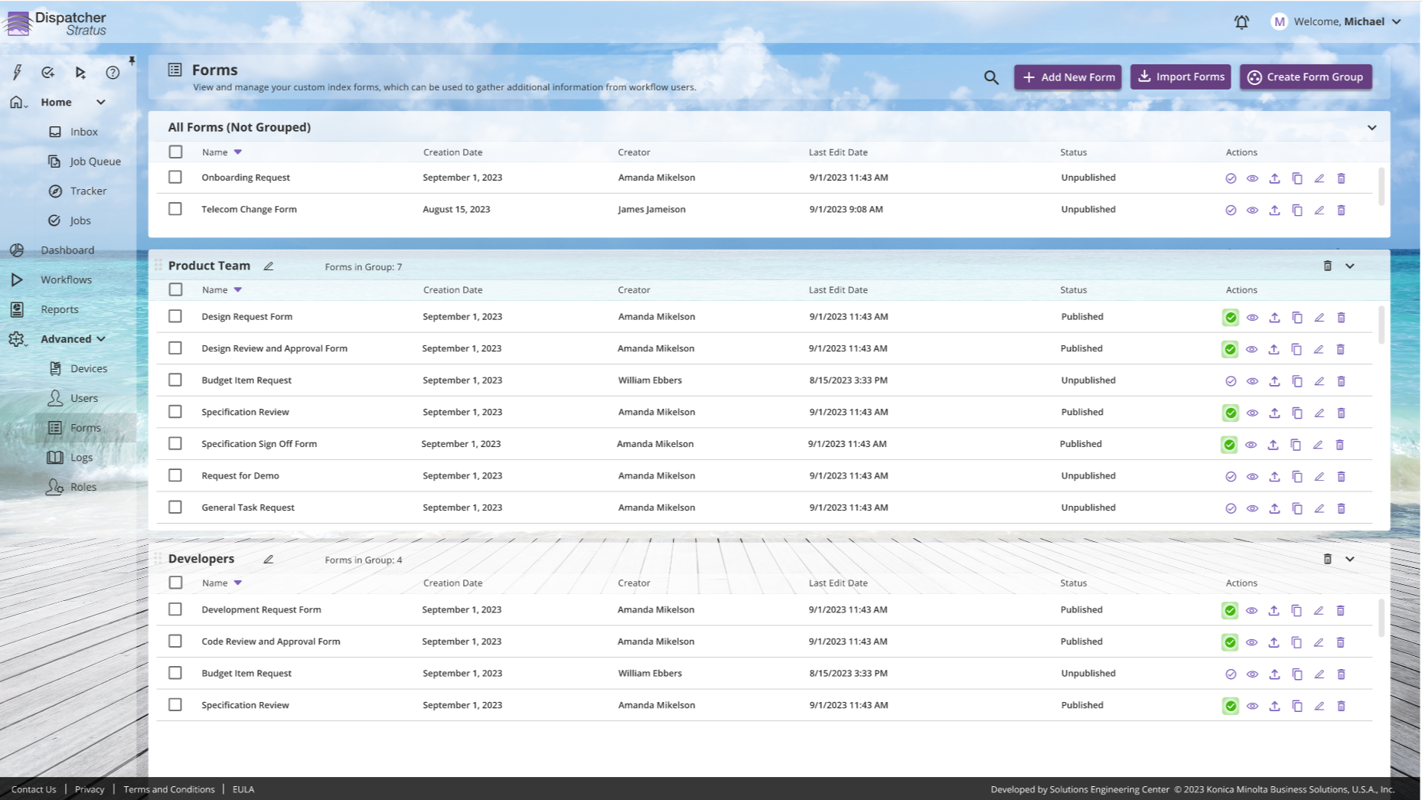
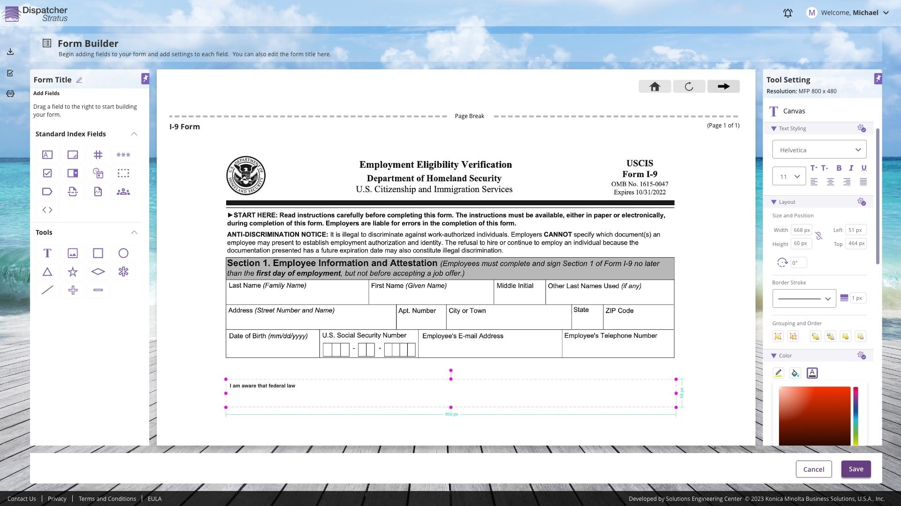
Advanced Forms
  Empower users to capture, route, and process documents.
  Quickly and easily publish forms for capture and indexing.
  Allow for data entry and verification at any point in the workflow.
  Flexible form creation for standard and advanced layouts.

Slide 20
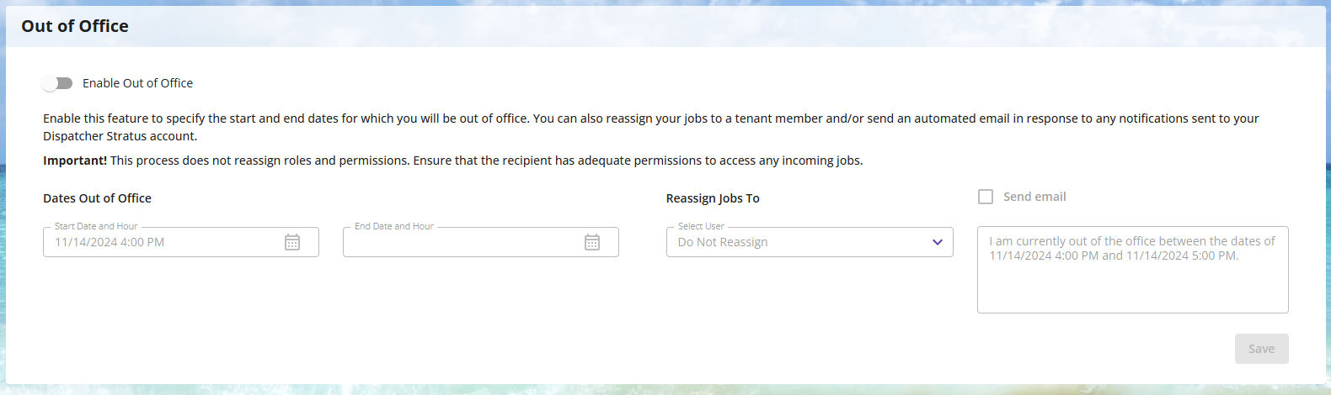
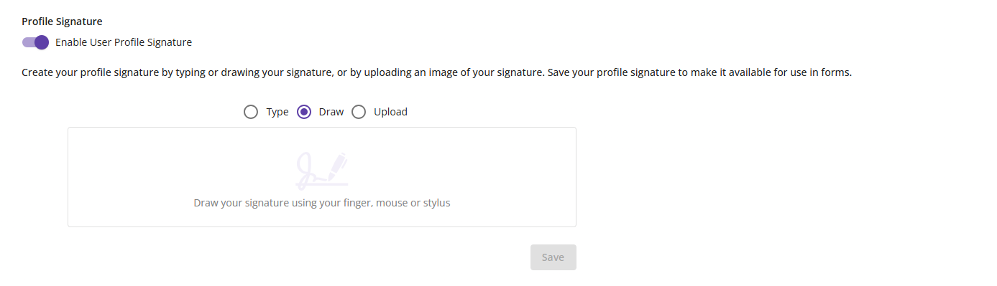
Task Management
  Coordinate around employee vacations with out-of-office settings
  Temporarily or permanently transfer ownership of items to another user to ensure processes remain on track
  Further streamline processes with automation for signatures
  Set automatic reminders for in process jobs to maximize productivity

Slide 21
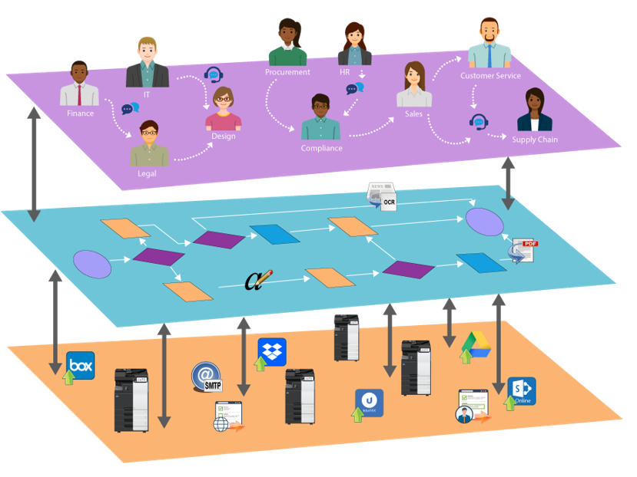
Enterprise & Vertical Capabilities
  Connectivity to other third-party systems
  Custom and advanced form configuration with CSS
  Advanced logic to support user-friendly and intelligent forms
  Healthcare document processing with HL7 and CDA
  Enterprise DMS Integrations

Slide 22
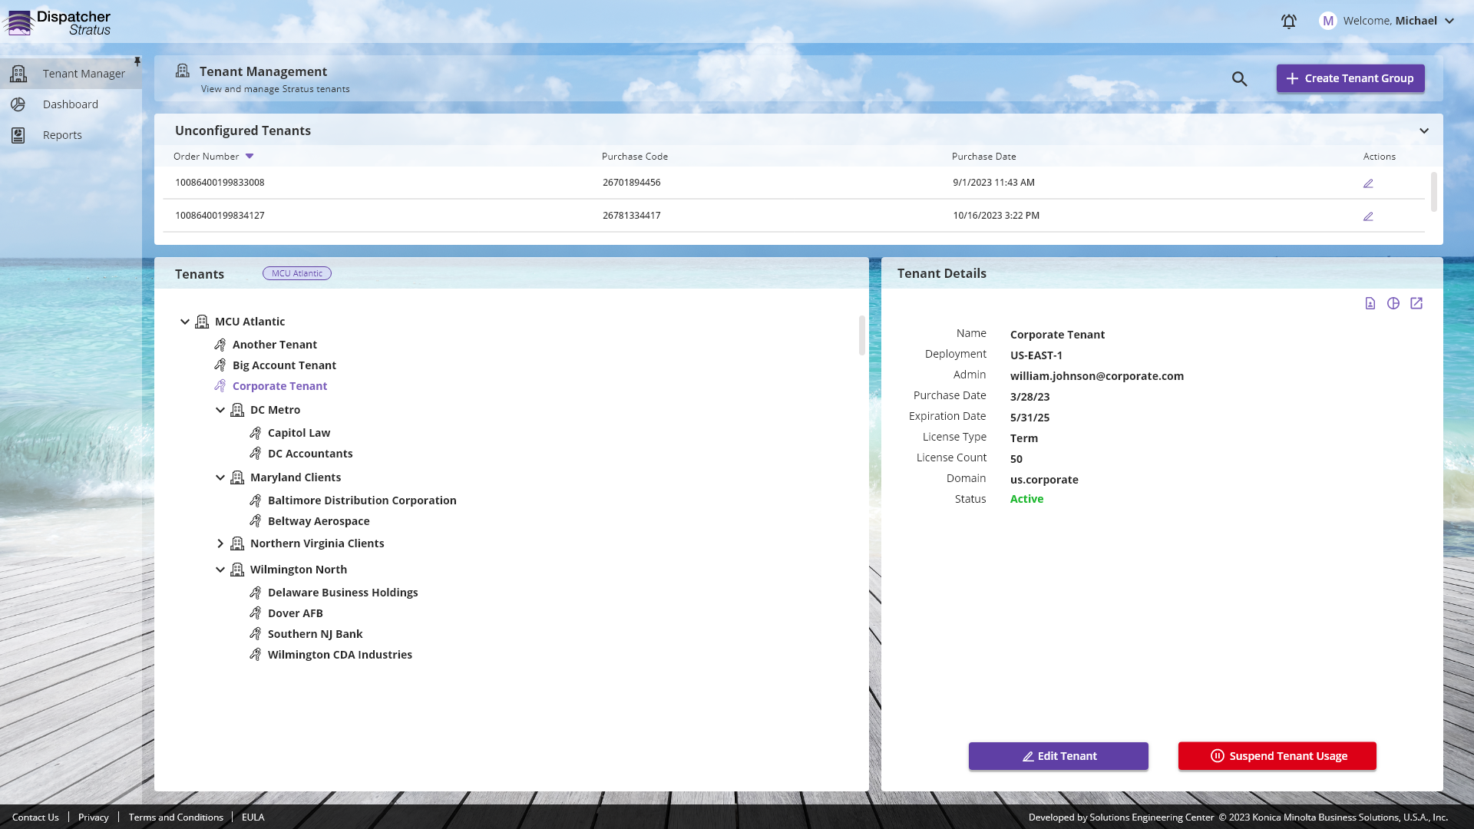
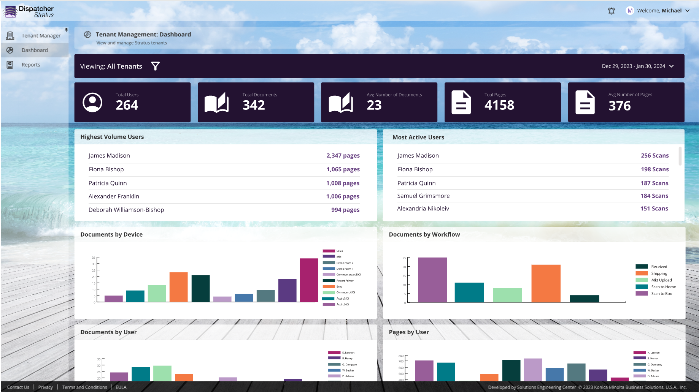
Customer Management
  Intuitively organize and manage your customer base in a single interface.
  Monitor customer activity, health, and status.
  Proactively address upcoming expirations, cancel unpaid licenses, and more!

Slide 23
Conclusion
Notes:
Let’s discuss some of the key features of the Dispatcher ScanTrip Cloud solution.

Slide 24
Identifying Opportunities for Automation
Start by analyzing business processes and identifying where there are manual actions such as:
Moving, updating, or checking the consistency of data from one system to another
Waiting for alerts/events to initiate their activities
Remediating data across several accounts
Important considerations:
Is the process something that can be clearly defined?
Is the process more driven by business rules or does human judgement take precedence?
Is the frequency or volume of the process significant enough to be considered for automaton?
Processes perfect for automation include those that:
Are run frequently
Take a large amount of time to complete manually
Require data from several sources
Contain information that requires review
Have a key dependencies
High risk of human error

Slide 25
Dispatcher Stratus Licensing
Device & User Based Licensing Options
Dispatcher ScanTrip Cloud
Dispatcher Stratus Starter
Traditional workflow automation in the cloud
Core scan workflows integrated with KM MFPs
Dispatcher Stratus Business
Standard people-based workflows
Dispatcher Stratus Enterprise
Advanced people-based workflows with ECM automation capabilities

Slide 26
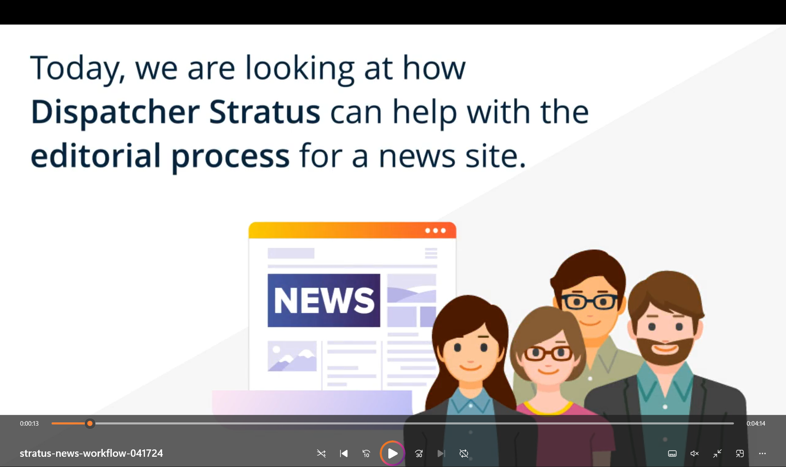
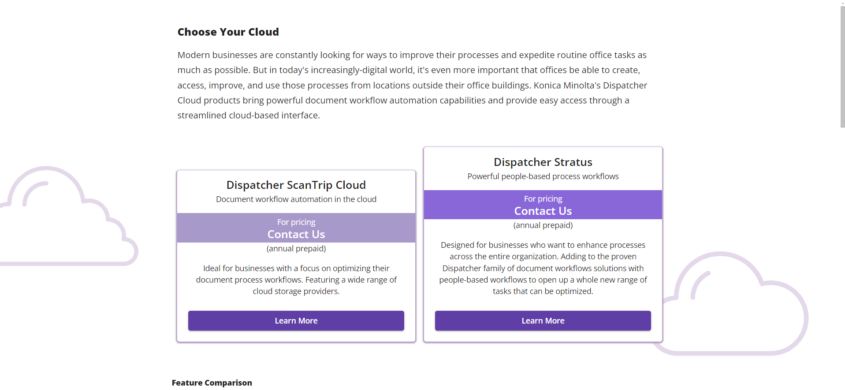
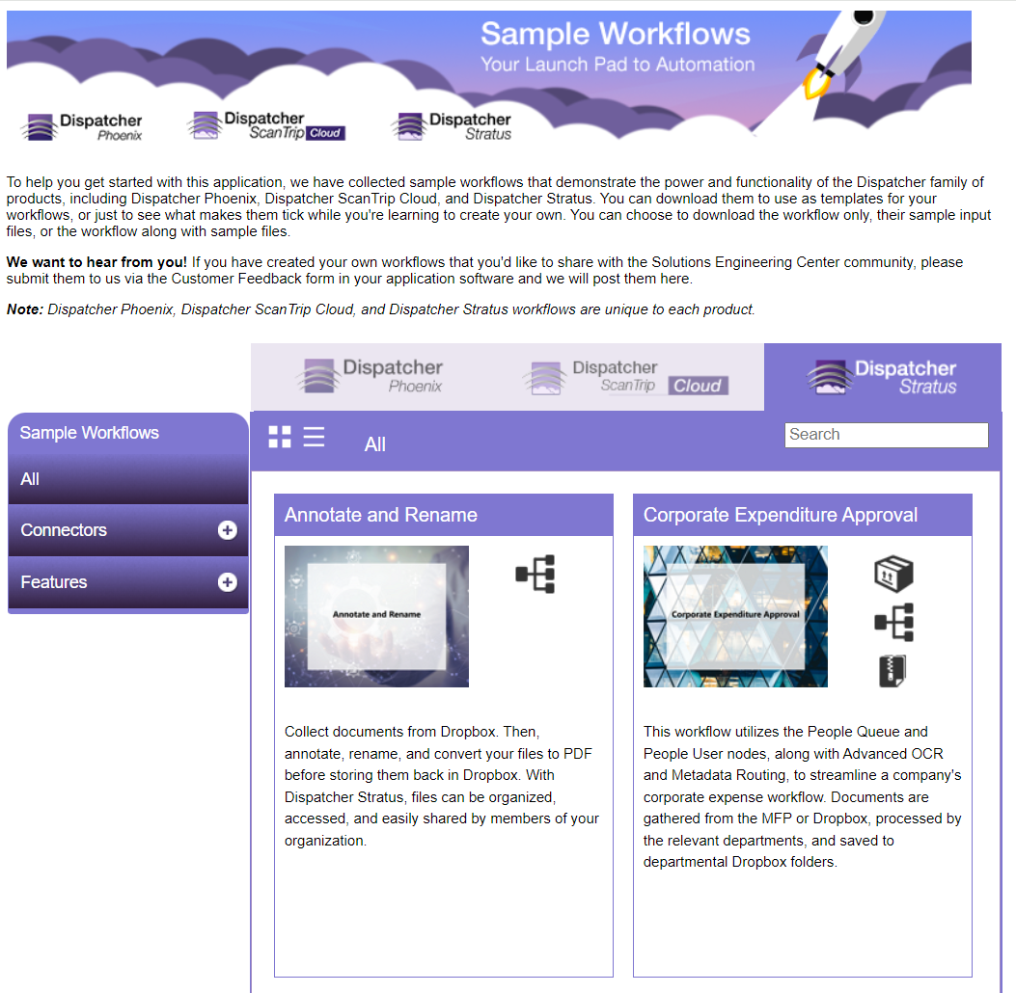
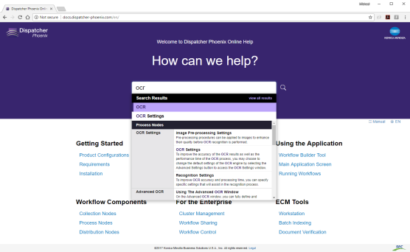
Resources
Brochure
Videos
Onboarding & Licensing Guides
Security & Other White Papers
Web Based Training
Sample Workflows
Online Help
15-Day Demo Licenses
Presentations
And more!

